Slide 1
Cyclist Data analysis using 2024 Data

Slide 2
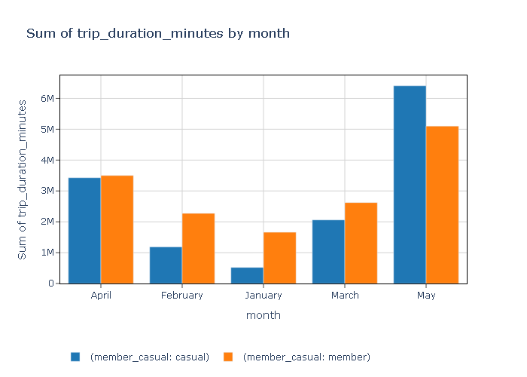
Total trip duration in minutes Monthwise

Slide 3
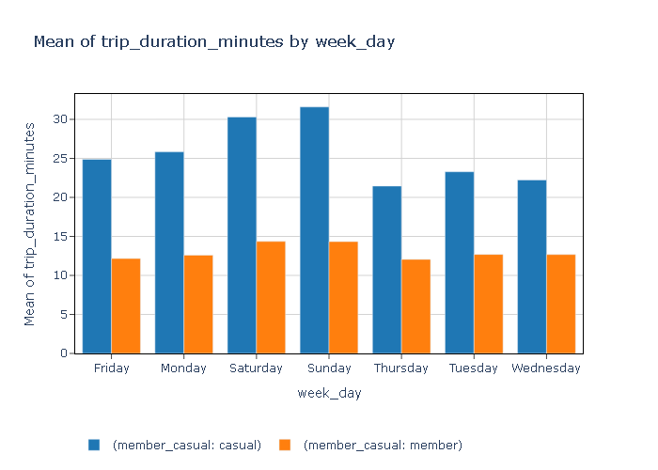
Mean Trip duration over weekdays

Slide 4
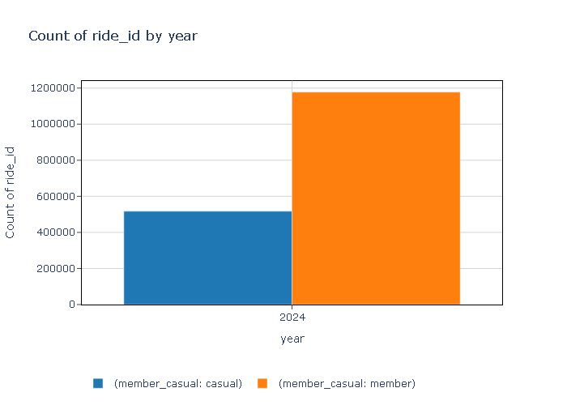
Casual vs member total trips -2024

Slide 5
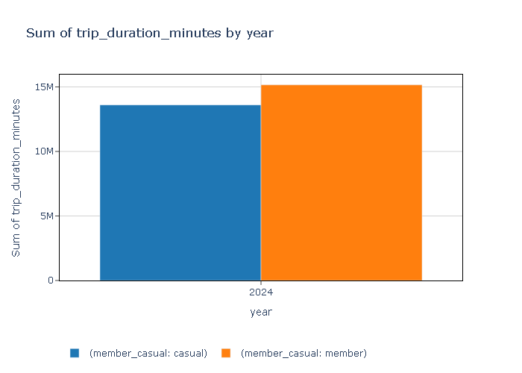
Casual vs member total trip duration -2024

Slide 6
Casual vs member Mean trip duration -2024

Slide 7
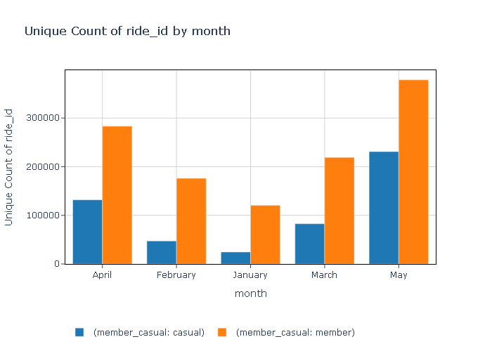
Total No of rides every Month

Slide 8
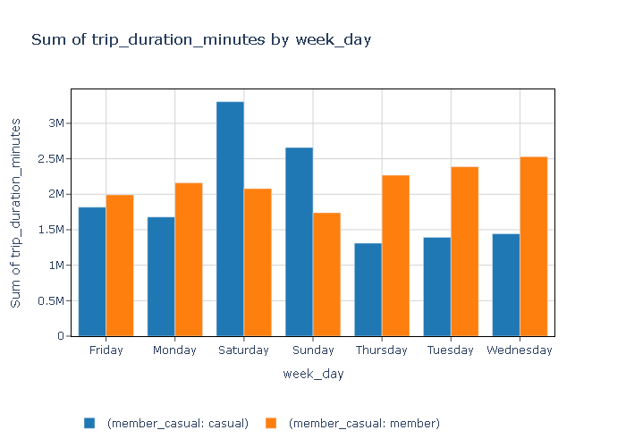
Casual vs members total trip duration Comparison week-o-week

Slide 9
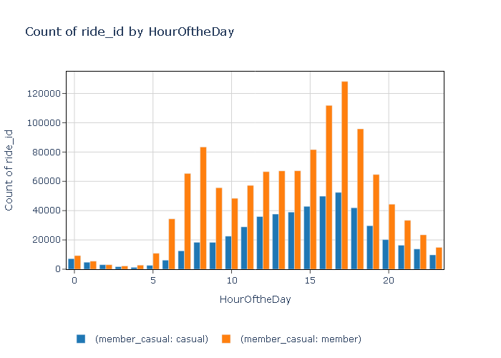
Overall Busiest Hour of the Day

Slide 10
Weekly Average Trip length cas Vs mem

Slide 11
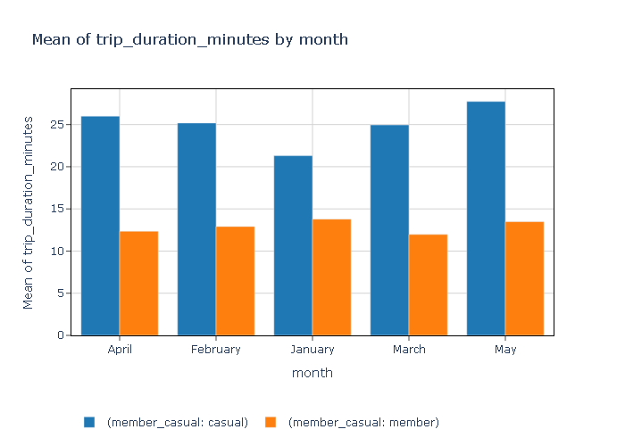
Monthly Average Trip length cas Vs mem

Slide 12
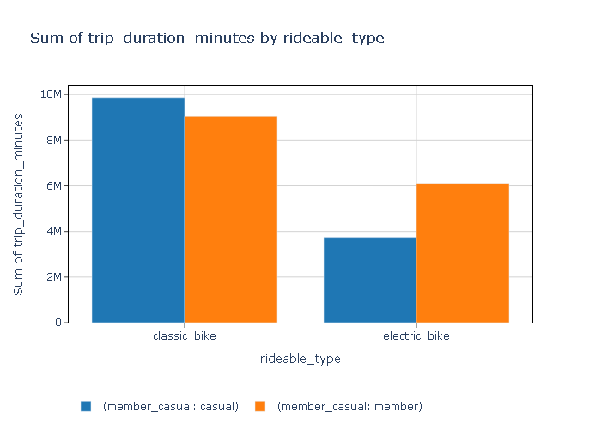
Popular ride type member vs casual

Slide 13
Total Valid Trips -1694241
Busiest Month – May (summer)
Peak Hour – 5PM
Favorite rideType – classic
Week ends casual riders usage is more than members.
Ride duration of casual riders is more than the members.
But Members contribute to the majority of the total ride duration as they use service morethan casual riders.
Weekend average of casual riders is morethan 30hrs.
Members show consistent average trip durations of around 15-16hrs, indicating they use the service for daily commute.

Slide 14
1. How do annual members and casual riders use Cyclistic bikes differently?
Answerable with current data:
Busiest Month – May (summer): Indicates when bike usage peaks, likely for both casual and annual members, but could show different usage patterns.
Peak Hour – 5PM: Suggests a common time for high usage, potentially related to commute times for members versus leisure times for casual riders.
Favorite Ride Type – Classic: Identifies the most popular bike type, potentially for both groups.
Weekends Casual Riders Usage > Members: Highlights a significant behavioral difference; casual riders use the service more on weekends.
Ride Duration of Casual Riders > Members: Indicates that casual riders tend to have longer rides on average.
Members Contribute More to Total Ride Duration: Despite shorter trips, members have more rides overall.

Slide 15
2. Why would casual riders buy Cyclistic annual memberships?
Additional analysis needed:
The insights suggest that casual riders tend to use bikes more on weekends and for longer trips. An analysis of cost savings from buying a membership versus paying per ride could be beneficial.
Weekend Membership Promotions: Target casual riders with weekend-only membership deals, emphasizing the savings and benefits of unlimited rides during their peak usage times.
Off-Peak Incentives: Introduce a "Weekend Warrior" membership with discounts during lower-usage hours on weekends to encourage more frequent rides.
Align with Peak Usage: Highlight the convenience and cost-effectiveness of a membership during high-demand periods like 5PM and the busy month of May, aligning with casual riders' habits.
In Summer offering a membership plan with the average hours that casual riders use could help conversions.

Slide 16
3. How can Cyclistic use digital media to influence casual riders to become members?
Additional analysis needed:
Knowing that weekends are popular for casual riders, targeted digital media campaigns could promote the benefits of membership (e.g., discounts for weekend trips, longer ride duration advantages) on these days.
Campaigns could highlight the value of a membership during the busiest month (May) and during peak hours to reduce the overall cost of frequent rides.

Slide 17
Next Steps:
For Question 2: Additional analysis like cost-benefit comparisons, survey data, or exploring what influences casual riders’ decisions during peak times or busy months could help.
For Question 3: Gathering data on digital engagement and aligning it with bike usage patterns will help create more targeted marketing campaigns.

